Slide 1
Legal Issues and Higher Education Coordinating Boards
Thomas W. Pennington
Professor of Legal Studies
Arkansas Tech University
2024 Annual Trustees Conference
March 26, 2024
University of Arkansas Pulaski Technical College

Slide 5
Athletics
Academics
Arts

Slide 6
Remote
Learning

Slide 9
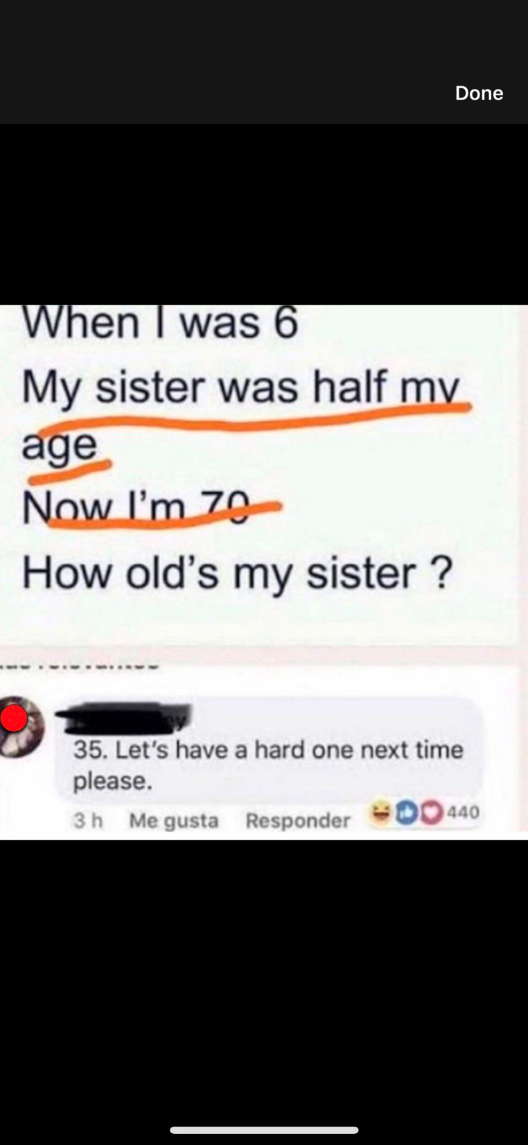

Slide 12
Legal Issues in Higher Education

Slide 13
1. Social Media
Northwest Arkansas Democrat Gazette, March 16, 2024.

Slide 14
O’Connor v. Ratcliff
Lindke v. Freed

Slide 15
Public officials sued for blocking critics on social media.

Slide 16
Officials must have the authority to speak on behalf of their governments and intend to use it (authority) for their posts to be regarded essentially as the governments.

Slide 17
Public officials can be sued for blocking or deleting critical commentary if a public employee has the “actual authority to speak on the state’s behalf” and “purported to exercise that authority” in the social media post at issue..
Washington Post, March 15, 2024

Slide 18
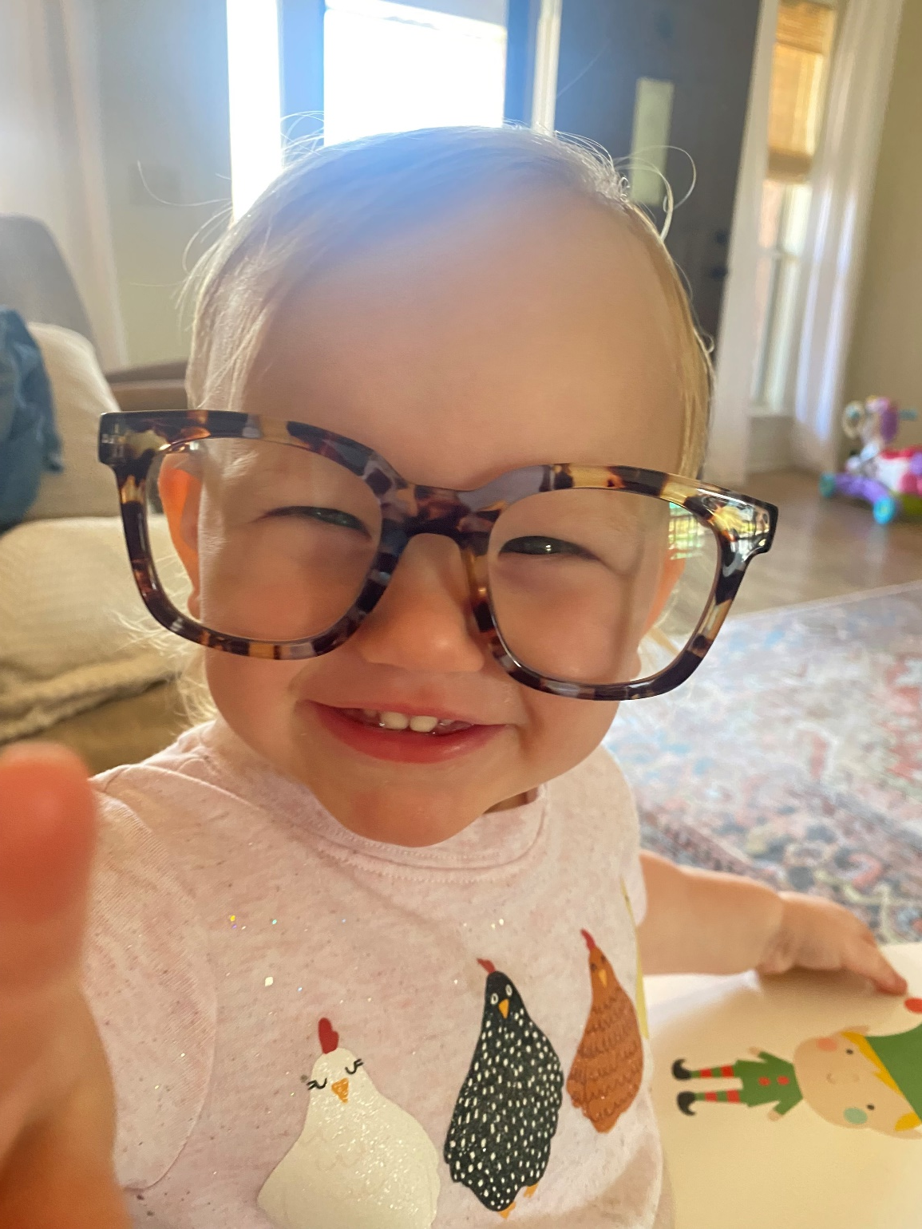

Slide 19
Hypothetical:
“Remove the cap on Medicare-funded residency slots.”

Slide 20
2. Clery Act
National Public Radio, March 4, 2024.

Slide 21
The Clery Act is a consumer protection law that aims to provide transparency around campus crime policy and statistics.

Slide 22
Annual crime report
October 1st each year.

Slide 23
Fine is $62,689
Per violation

Slide 24
3. Athletics – Part One
Northwest Arkansas Democrat Gazette, February 24, 2024.

Slide 25
1. NCAA rule prohibited 3rd parties from paying recruits to attend a particular school.
2. Court granted preliminary injunction against NCAA.
3. NCAA’s prohibition likely violates federal antitrust laws.
4. Lawsuit did not challenge NCAA NIL rule that prohibits linking NIL to athletic performance (so amateurism is still protected).
5. Lawsuit is in it’s infancy and is a long way from over.

Slide 26
3. Athletics – Part Two
Wall Street Journal, March 6, 2024.

Slide 27
1. February 5, 2024, a National Labor Relations Board (NLRB) official ruled that members of the Dartmouth men’s basketball team are employees of the school and entitled to unionize.
2. On March 5, 2024, the men’s basketball team voted to join the Service Employees International Union Local 560.
3. March 14, 2024, NLRB certified the union to represent the basketball players.
4. Absent an appeal, the players and school will now negotiate a collective bargaining agreement that will cover working conditions such as salary, practice hours, and healthcare benefits.

Slide 28
4. Sexual Harassment
JDSUPRA, March 7, 2024.

Slide 29
5. Freedom of Information Act
1. Recent changes and more on the horizon.
2. Public (K-12) schools can have attorney in executive session. Public colleges and universities cannot.
JDSUPRA, March 7, 2024.

Slide 30
5. Freedom of Information Act, cont’d.
3. Act 879 of 2023 requires a response.
4. Ongoing efforts to have state constitutional amendment.

Slide 31
A word of thanks.

Slide 32
Questions?

